Slide 1


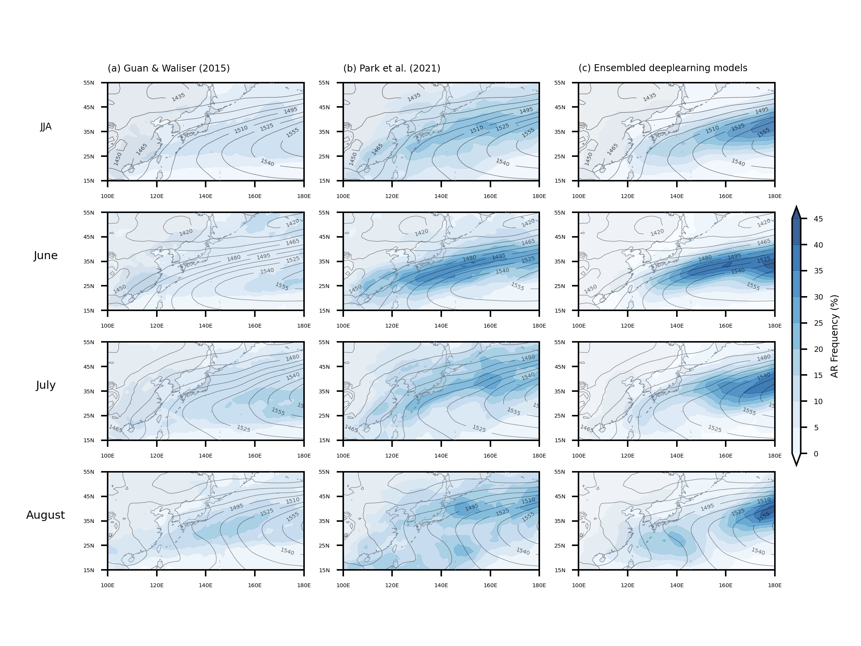
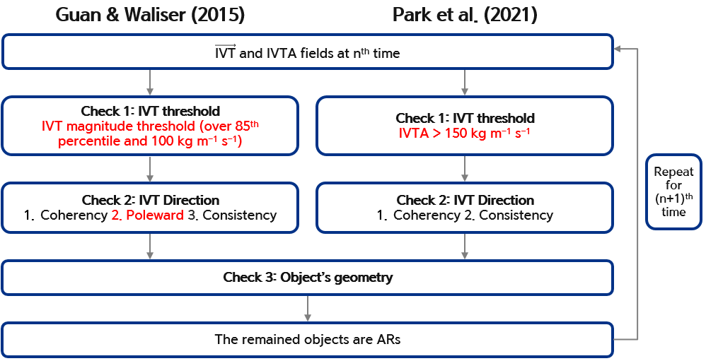
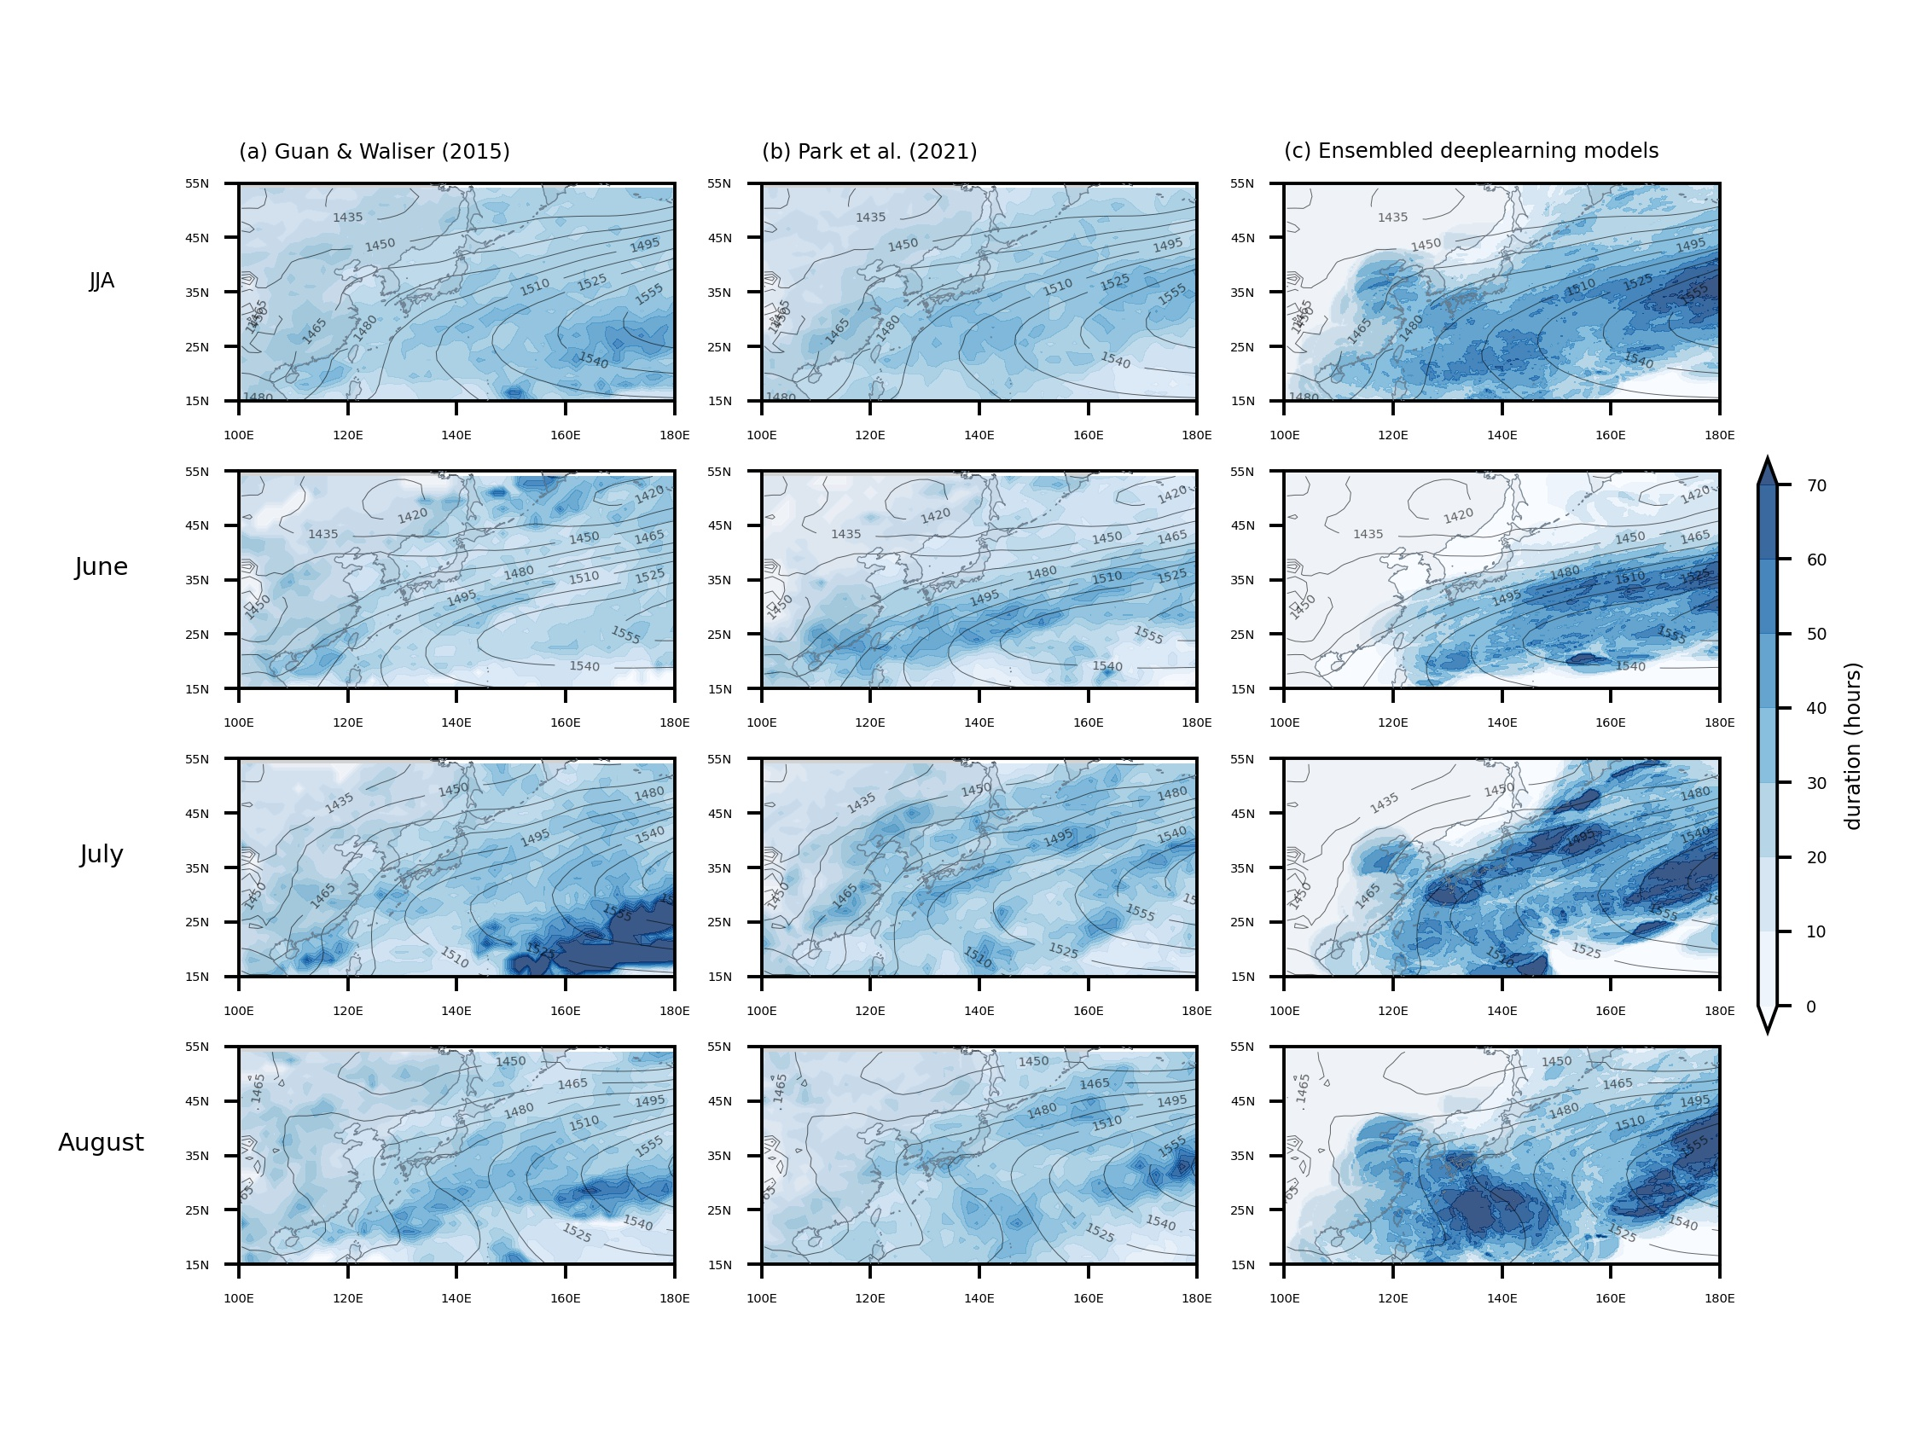
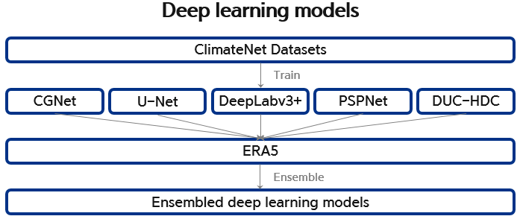
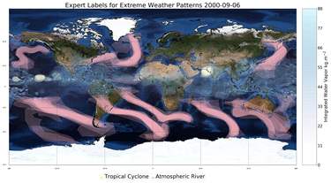
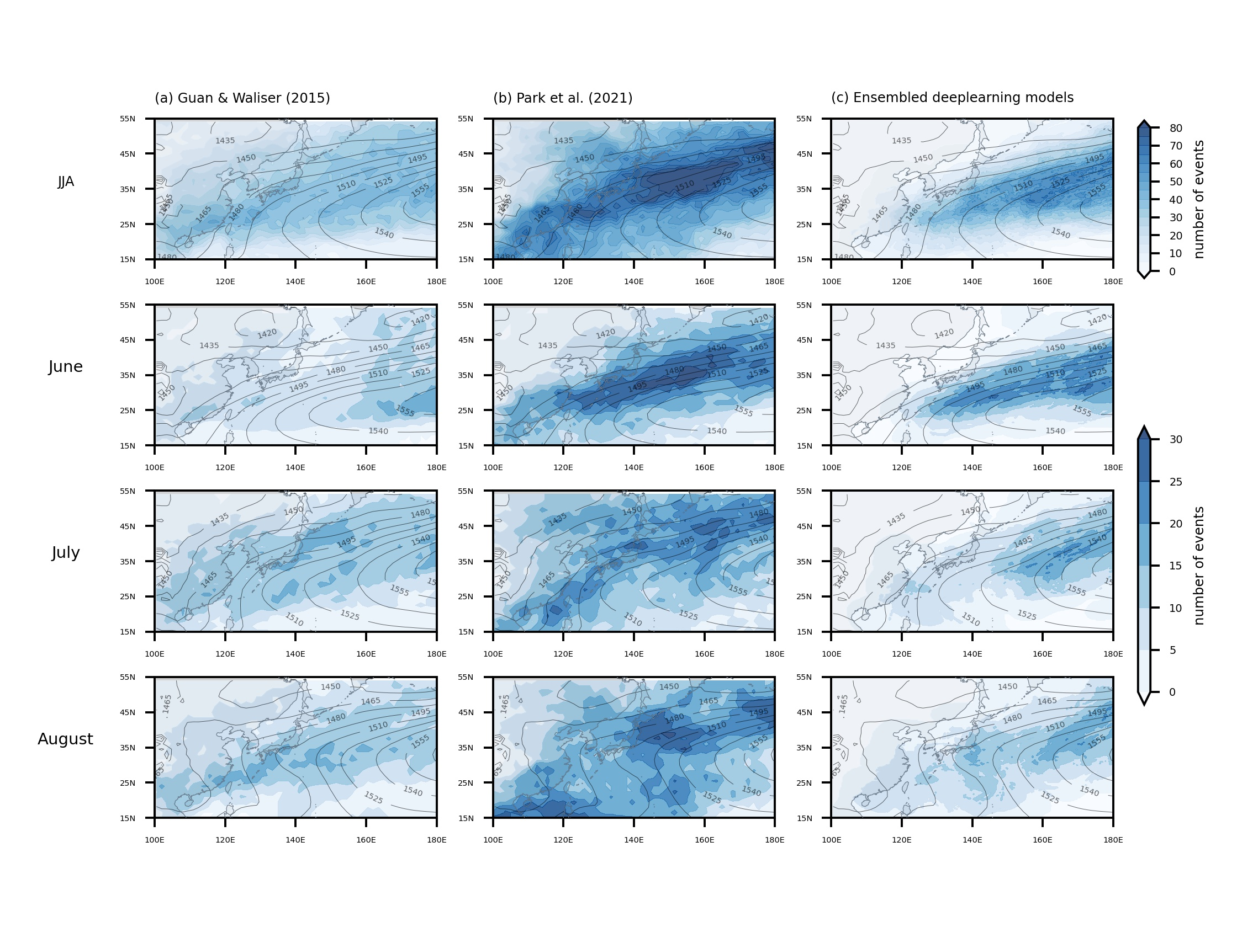
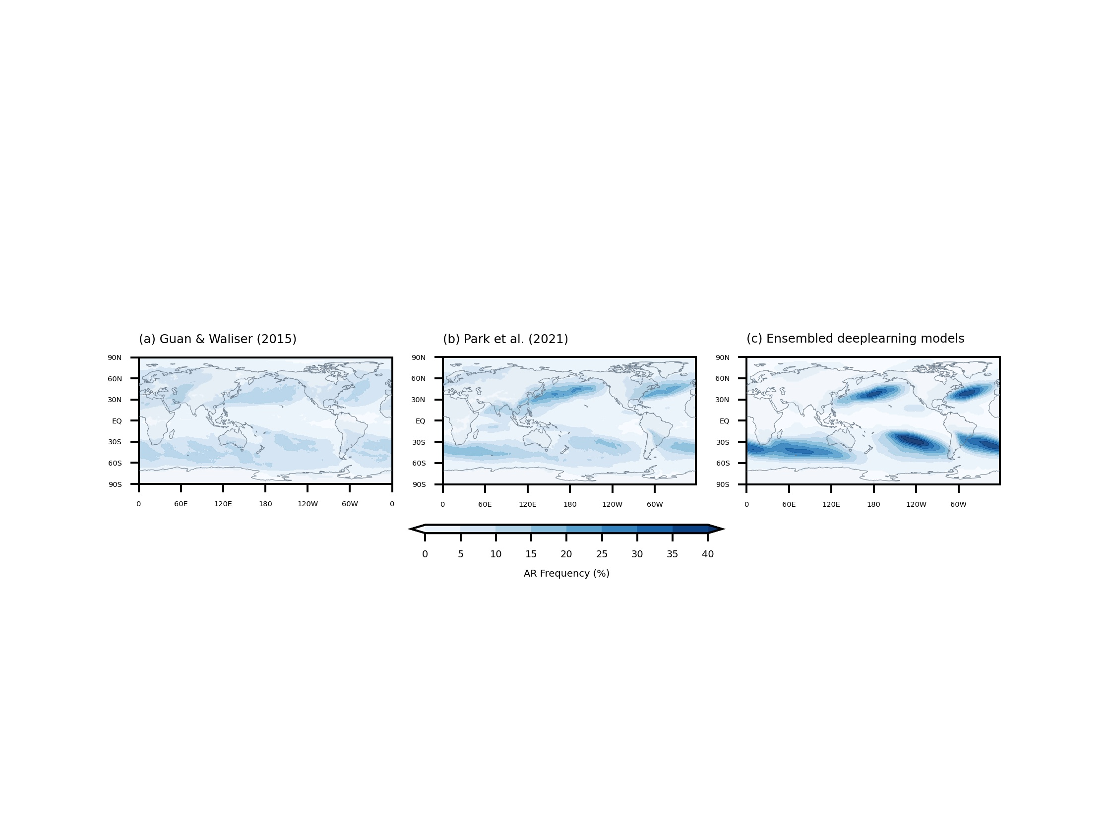
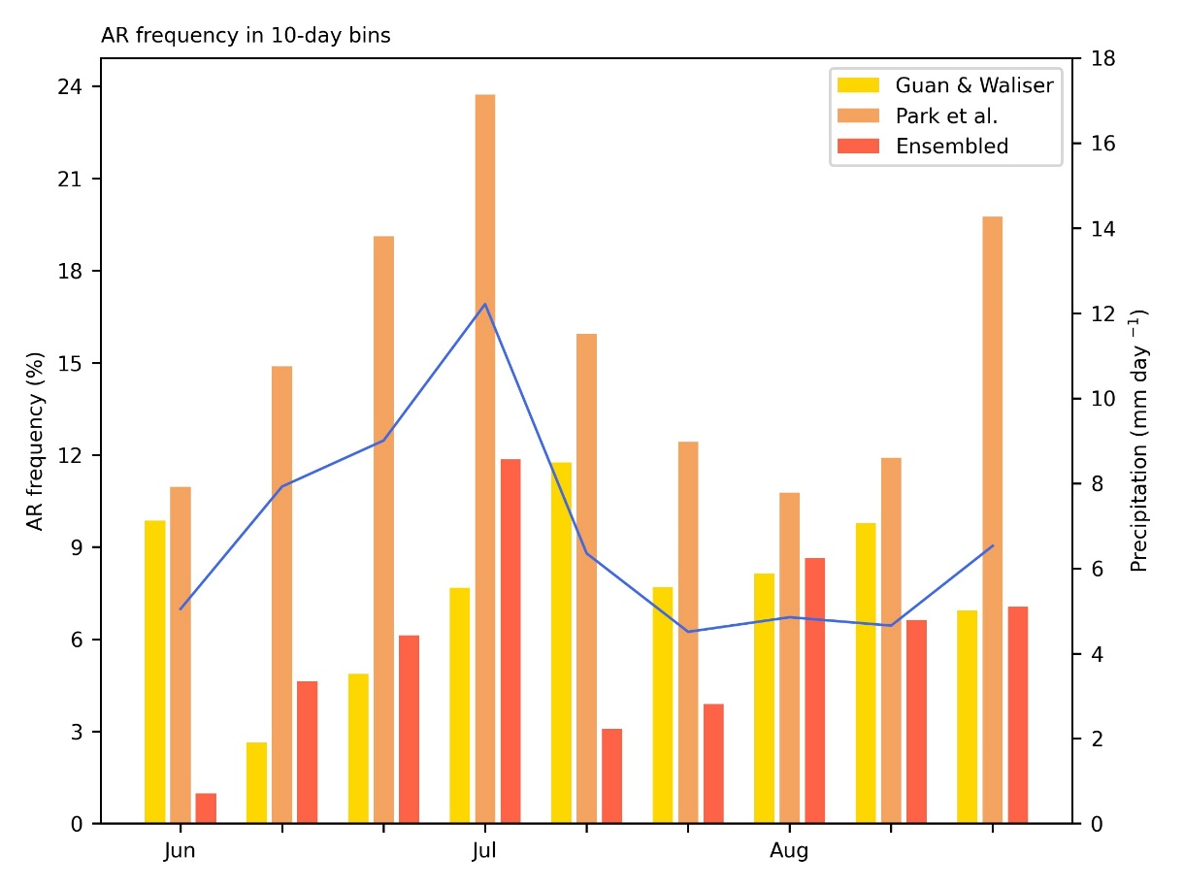
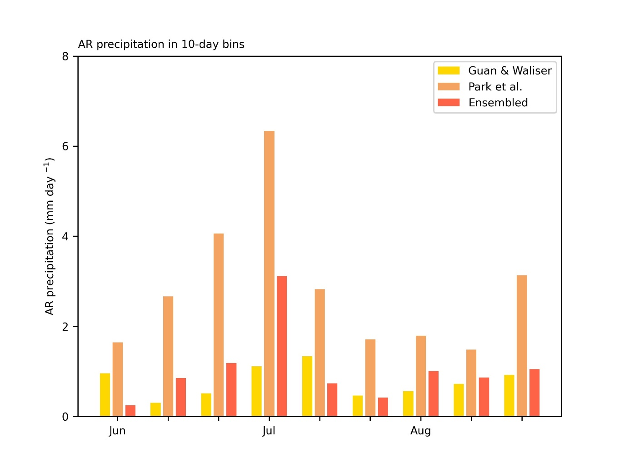
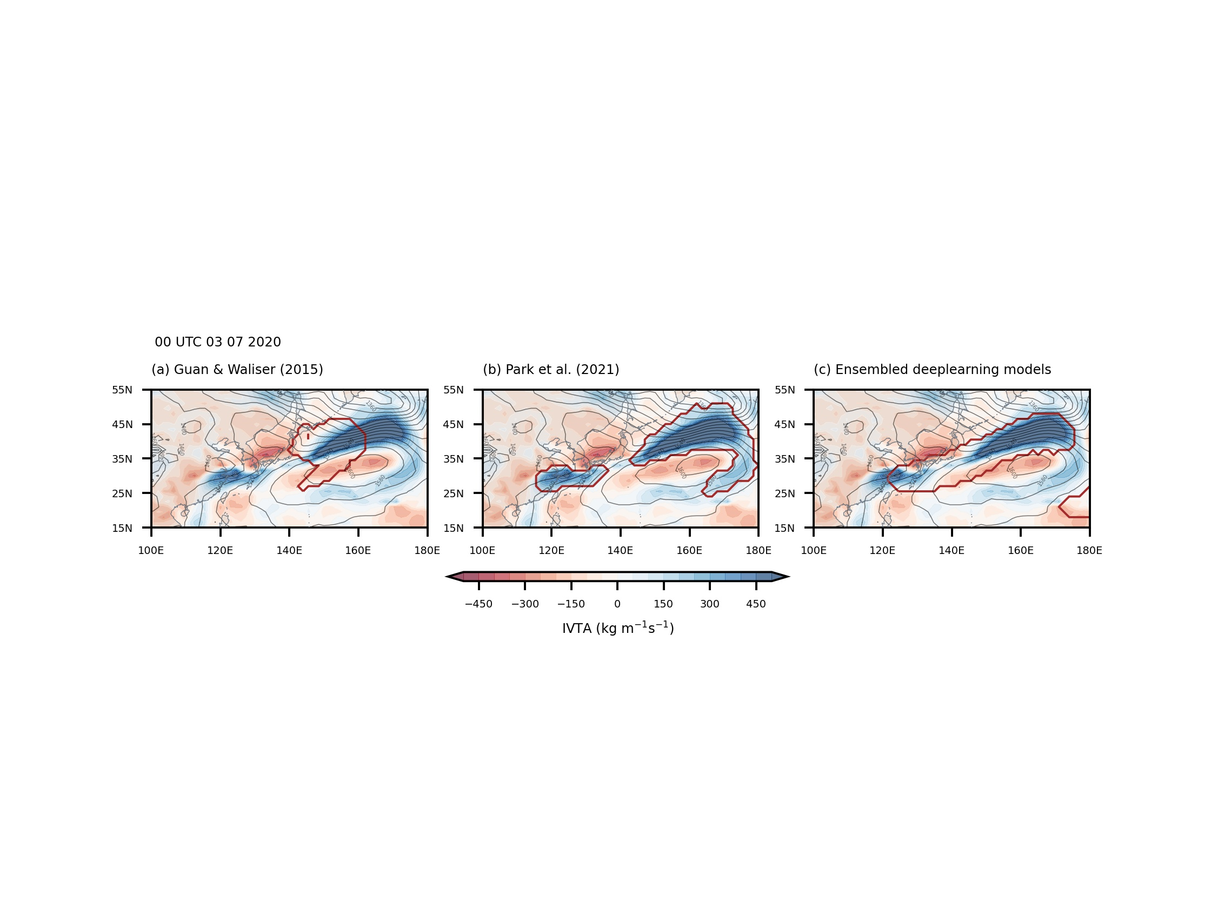
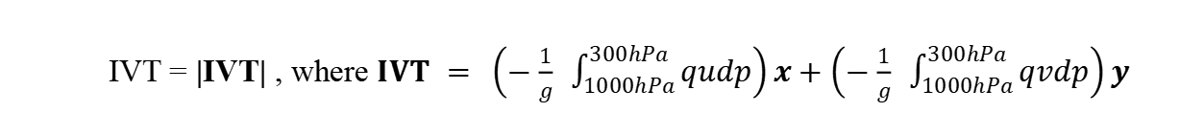
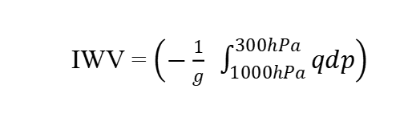
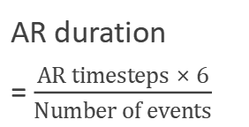
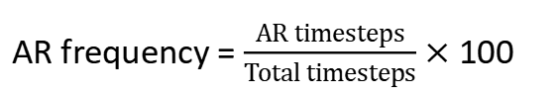
동아시아 여름철 대기의 강 탐지 알고리즘 비교
Comparison of Atmospheric River detection algorithms in East Asian summer
김규리, 백승윤, 권예은 , 손석우
서울대학교 자연과학대학 지구환경과학부
Introduction
3) East Asia AR frequency
Fig.5 | Seasonal-mean (JJA) and monthly climatology of AR frequency (%, shaded) and 850-hPa geopotential height (gpm, contoured) in East Asia.
Atmospheric Rivers (ARs) are narrow, elongated, synoptic jets of water vapor associated with high-impact weather events and long-term water supply in many regions. Since they are closely related to extreme precipitation, the importance of accurately detecting ARs is increasing.
Currently existing detection algorithms mostly use thresholds based on water vapor transport, however, there is a problem that the thresholds are different among algorithms. Therefore, the necessity for a more objective method of detecting AR is arising.
In this study, deep learning models based on convolutional neural networks (CNN) were used to detect East Asian summer ARs, and compared with the existing detection algorithms of Guan and Waliser (2015) and Park et al. (2021).
Dataset
 | Data | Period | Season | Timescale | Resolution
Detection | ERA5 (ECMWF Reanalysis v5) | 2016-2020 | Jun-Aug | 6 hourly | 1.5°×1.5°
Precipitation | GPCP (Global precipitation Climatology Project) | 2016-2020 | Jun-Aug | Daily | 1°×1°
Detection Algorithms
In East Asia, Guan & Waliser shows the weakest frequency, while Park, which reflects East Asian AR characteristics, shows the stronger frequency.
DLE model has a similar frequency distribution to Park but shows the largest frequency and concentrated distribution in the east.
IWV = $\left(−\frac{1}{g} \int_{1000hPa}^{300hPa}{qdp}\right)$
IVT = |IVT| , where $IVT = \left(−\frac{1}{g} \int_{1000hPa}^{300hPa}{qudp}\right)x+\left(−\frac{1}{g} \int_{1000hPa}^{300hPa}{qvdp}\right)y$
4) East Asia AR duration and number of events
AR duration
= $\frac{AR timesteps × 6}{Number of events}$
Fig.1 | Atmospheric river detection procedure flowchart of algorithm from Guan & Waliser (2015) and Park et al. (2021)
Fig.6 | Seasonal-mean (JJA) and monthly duration of ARs (hours, shaded) and 850-hPa geopotential height (gpm, contoured) in East Asia.
Fig.2 | Atmospheric river detection procedure flowchart using ensembled deep learning models.
(Probhat et al. (2021))
For training, ClimateNet Datasets were used, which were labeled by weather and climate scientists.
It consists of 449 June-September cases, from 1996 to 2013. The resolution is 0.234° × 0.3125° and used IWV, U850, V850
Results
1) Global AR frequency
Fig.7 | Seasonal-mean (JJA) and monthly number of AR events (shaded) and 850-hPa geopotential height (gpm, contoured) in East Asia.
The strong frequency of Park is explained by frequent AR events, and the strong frequency of DLE model is explained by long duration and frequent events.
Fig.3 | Seasonal-mean (JJA) climatology of AR frequency (%, shaded) in global.
AR frequency = $\frac{AR timesteps}{Total timesteps}×$ 100
5) South Korea and Western Japan AR precipitation
Fig.9 | The AR precipitation (mm day⁻¹, blue) of Guan & Waliser (2015), Park et al. (2021) and ensembled deep learning models in 10-day bins in South Korea and Western Japan (boxed region; 30~40.5°N, 124.5~138°E).
DLE(Deep learning ensembled) model shows the strongest AR frequency than the detection algorithm of Guan & Waliser and Park.
All three detection algorithms have similar AR frequency distributions. Guan & Waliser shows globally even frequency, Park shows the strongest frequency in East Asia, and DLE model shows the strongest frequency in the South Pacific.
Fig.8 | The AR frequency (%) and total precipitation (mm day⁻¹, blue) in 10-day bins in South Korea and Western Japan (boxed region; 30~40.5°N, 124.5~138°E).
2) East Asia AR detection case
In South Korean and Eastern Japan region, variance, maximum and minimum peaks between the AR frequency of Park and DLE model and total precipitation well corresponded.
Park explains AR precipitation the most, DLE and Guan & Waliser follow.
Summary
There was a significant difference between AR detection results depending on which detection algorithm was used.
AR detection algorithms of DLE model, Guan & Waliser, and Park detected ARs distribution qualitatively similarly, however, DLE model relatively showed stronger frequency and longer duration.
The reason for the stronger frequency of Park could be explained by frequent AR events, and DLE by longer AR duration and frequent AR events.
With improvements in the training set, there is a possibility of improvements on DLE detection results.
Fig.4 | Example of East Asian ARs on 00 UTC July 3rd, 2020. The figure shows the 850-hPa geopotential height (gpm, contoured), IVTA (kg m⁻¹ s⁻¹, shaded), and ARs (thick red line) detected by (a) algorithm from Guan & Waliser (2015), (b) algorithm from Park et al. (2021), and (c) ensembled deep learning models.
Variability between each detection algorithm is high according to the different thresholds, and DLE model detected ARs more widely than the other two.
judygyurikim@snu.ac.kr
IWV: 연직 적분된 수증기 (integrated water vapor)
IVT: 연직 적분된 수증기 수송 (integrated water vapor transport)

Slide 2
